Slide 1
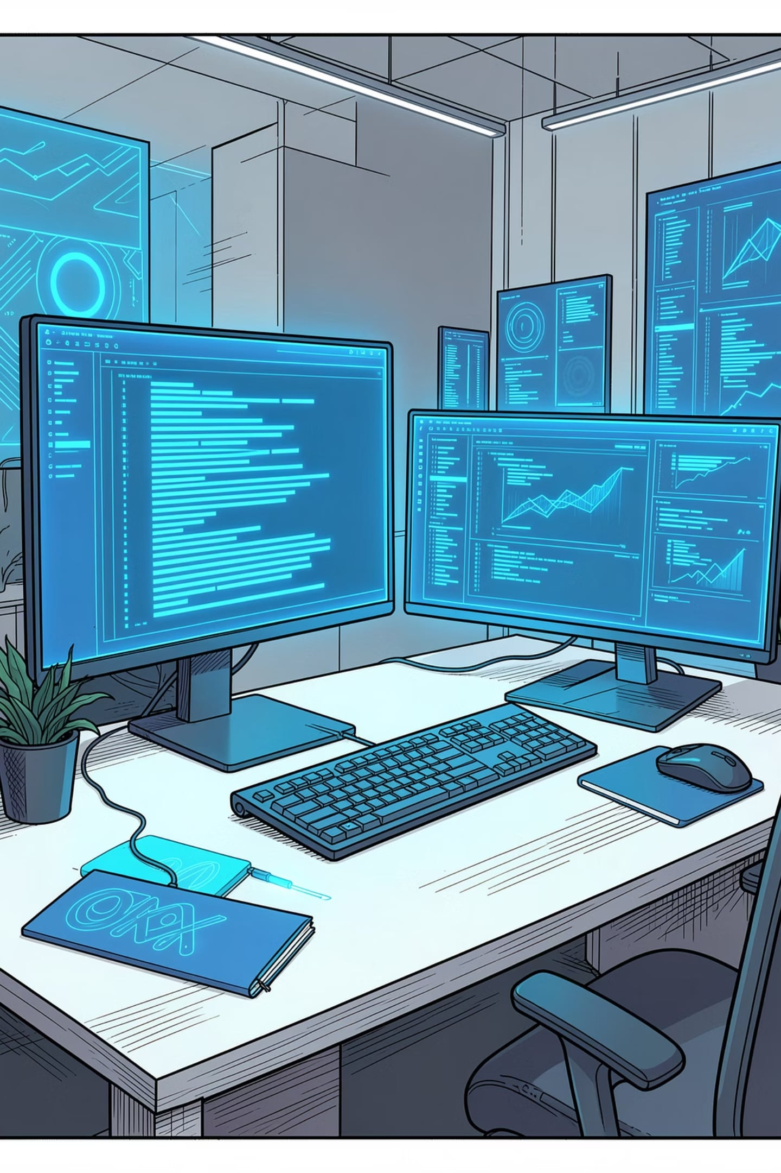
Capstone Project
APEXPLANET SOFTWARE PVT. LTD.
INTERNSHIP TASK 5
[STUDENT NAME:AKSHITHA BODANAPU] ·
[COLLEGE NAME:SRI SAI INSTITUTE OF TECHNOLOGY AND SCIENCE] ·

Slide 2
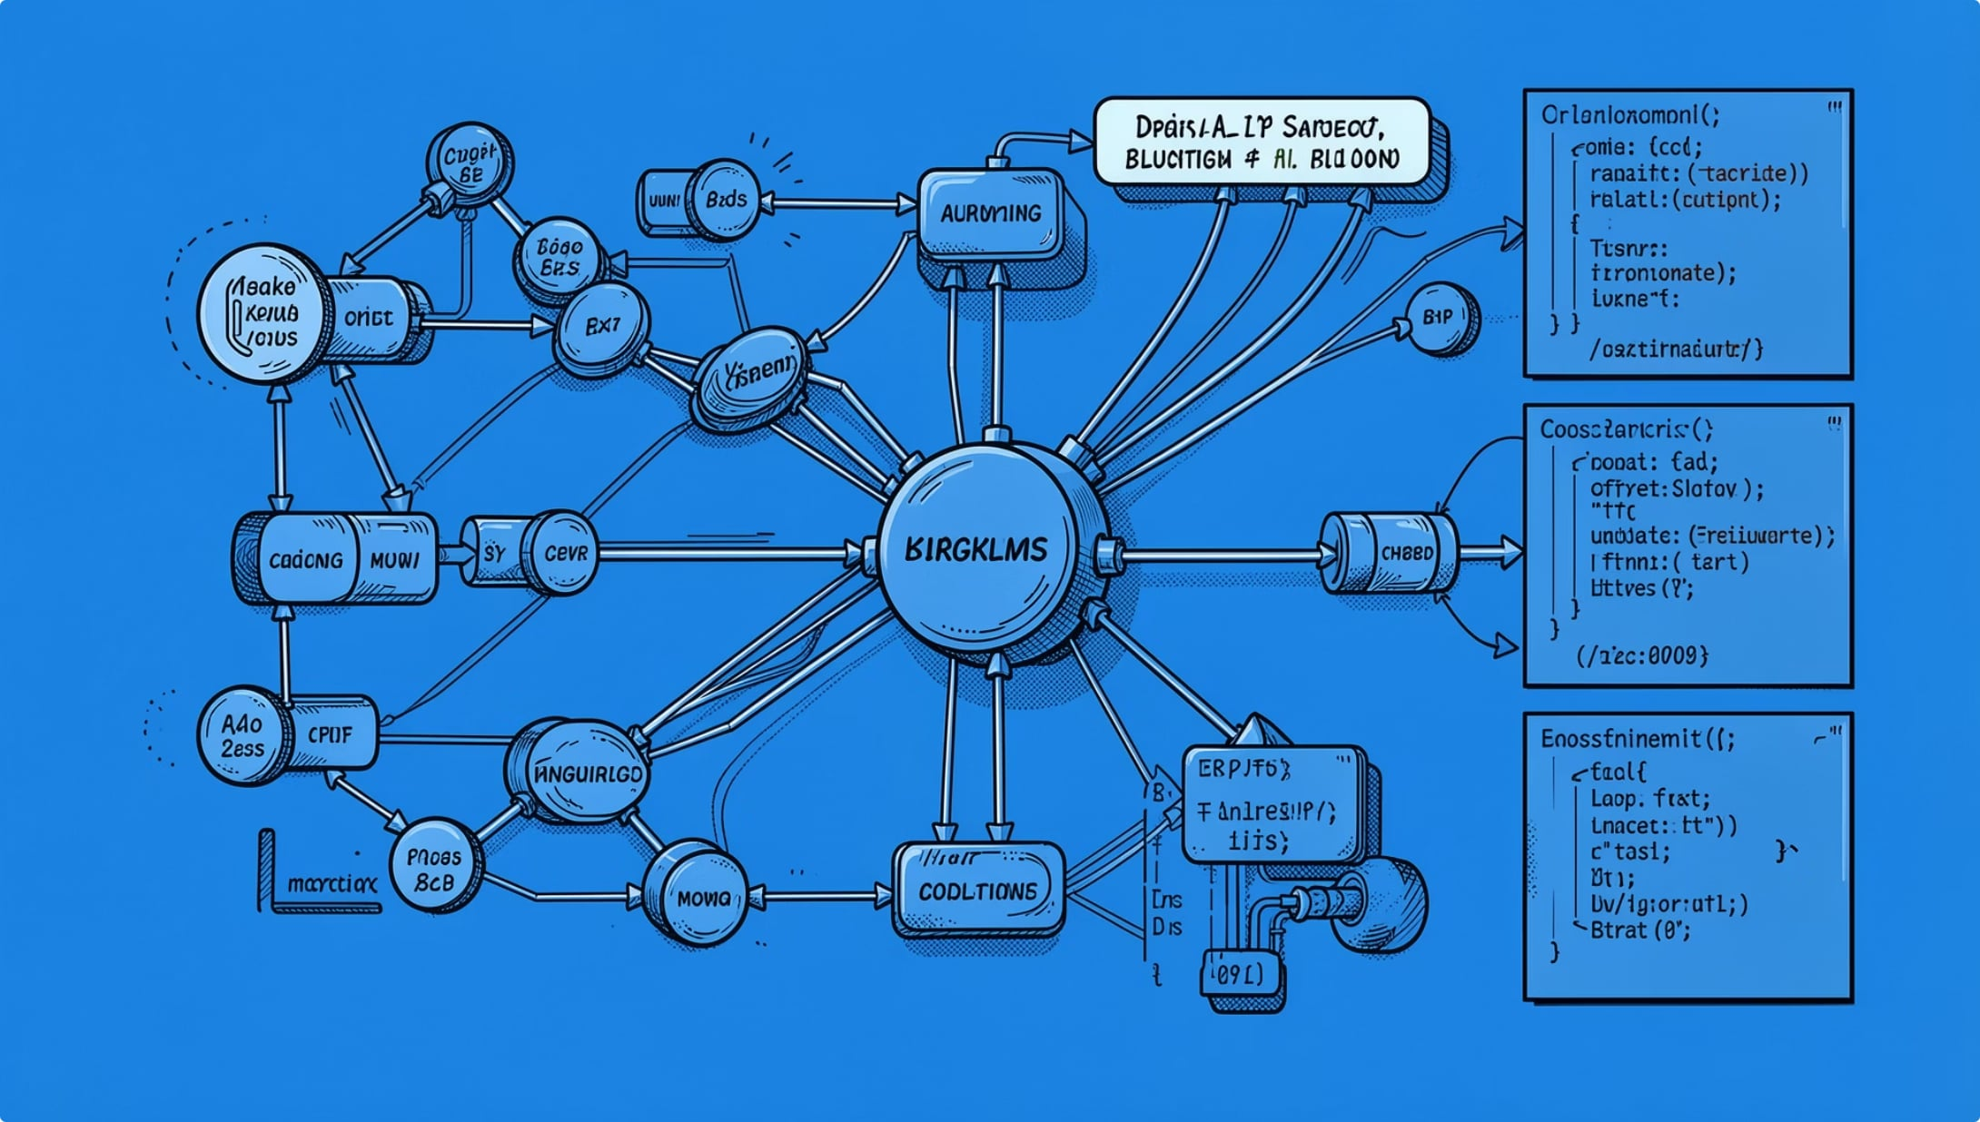
Project Overview
What We Built
A full-stack web application designed to solve a real-world problem, built during the ApexPlanet internship program. The project integrates front-end and back-end technologies into a cohesive, production-ready solution.
Objectives
Deliver a functional, user-centric application
Apply industry best practices in software development
Demonstrate end-to-end project ownership
Technologies Used
Python · HTML · CSS · JavaScript · GitHub · VS Code

Slide 3
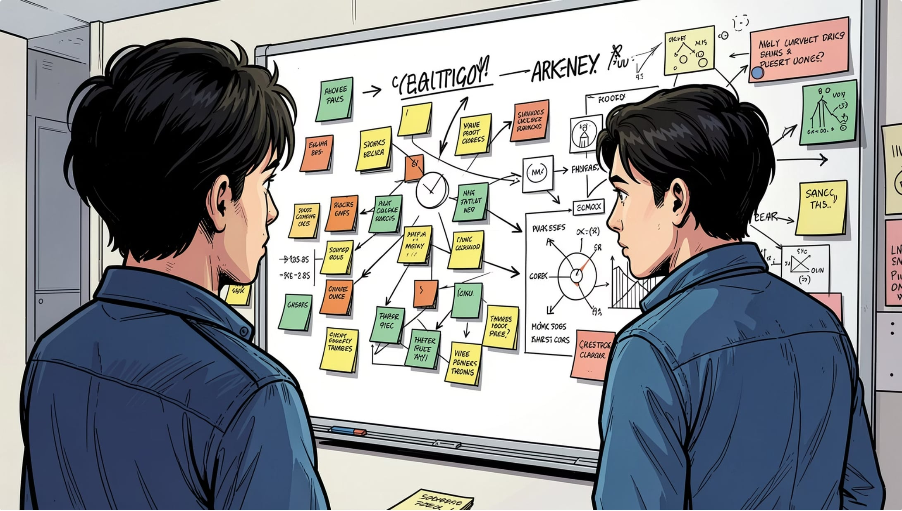

Problem Statement
The Challenge
Many small-to-medium businesses lack affordable, accessible tools to manage their day-to-day operations efficiently. Existing solutions are either too complex or too expensive for everyday use.
Why It Matters
Without a streamlined system, teams lose productivity to manual processes, data inconsistencies, and communication gaps — directly impacting growth and customer satisfaction.
Expected Outcome: A lightweight, intuitive application that simplifies core workflows and reduces operational overhead.

Slide 4






Tools & Technologies
Python
HTML & CSS
Back-end logic, data processing, and API integration
Responsive, semantic structure with modern styling
JavaScript
GitHub
Dynamic interactivity and client-side behavior
Version control, collaboration, and code reviews
VS Code
Additional Tools
Primary IDE with extensions for productivity
Git, Browser DevTools, and testing frameworks

Slide 5





Project Features
User-Friendly Interface
Responsive Design
Core Functionalities
Intuitive navigation designed for users of all skill levels
Seamless experience across desktop, tablet, and mobile
Feature-complete implementation of all project requirements
Error Handling
Clean Code Structure
Graceful fallbacks and clear user feedback on failures
Modular, readable, and well-documented codebase

Slide 6






Project Workflow
The project followed a structured development lifecycle — from initial planning through deployment and ongoing maintenance — ensuring quality at every stage.
Planning
Design
Requirements gathering and scope definition
UI/UX wireframes and architecture planning
Development
Testing
Front-end and back-end implementation
Unit tests, integration tests, and QA
Deployment
Maintenance
Live environment setup and launch
Bug fixes, updates, and monitoring

Slide 7
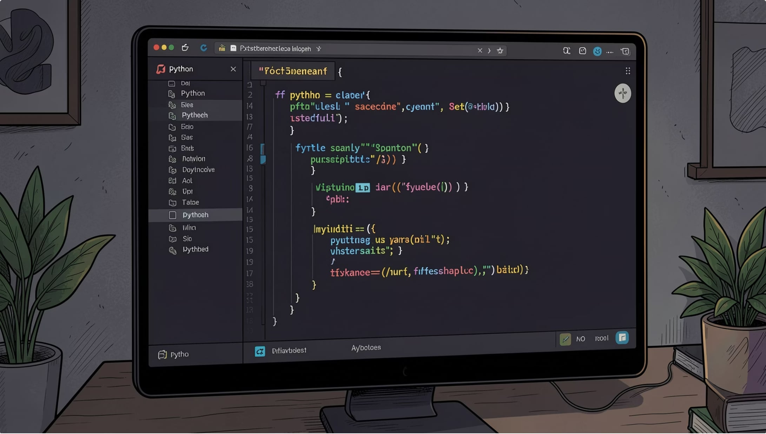

Implementation
Development Process
The application was built iteratively, with features developed in sprints. Each module was reviewed, tested, and merged via GitHub pull requests to maintain code quality.
Key Highlights
Modular component architecture for scalability
RESTful API design for back-end communication
Consistent commit history on GitHub
Code reviews aligned with ApexPlanet standards
Repository: github.com/[your-username]/[project-repo]

Slide 8
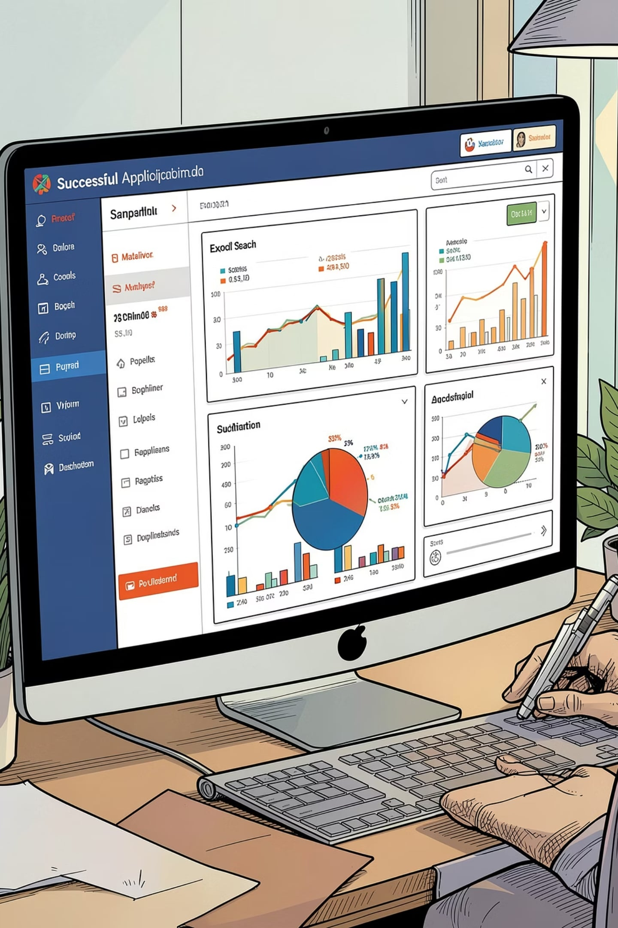
Results & Output
100%
Features Delivered
All planned features implemented and verified
5+
Modules Built
Independent, testable components in the app
0
Critical Bugs
Zero critical issues at final deployment
1
GitHub Repo
Fully documented, version-controlled project
The final application passed all functional and integration tests. The UI renders correctly across all target devices, and the back-end handles edge cases gracefully.

Slide 9
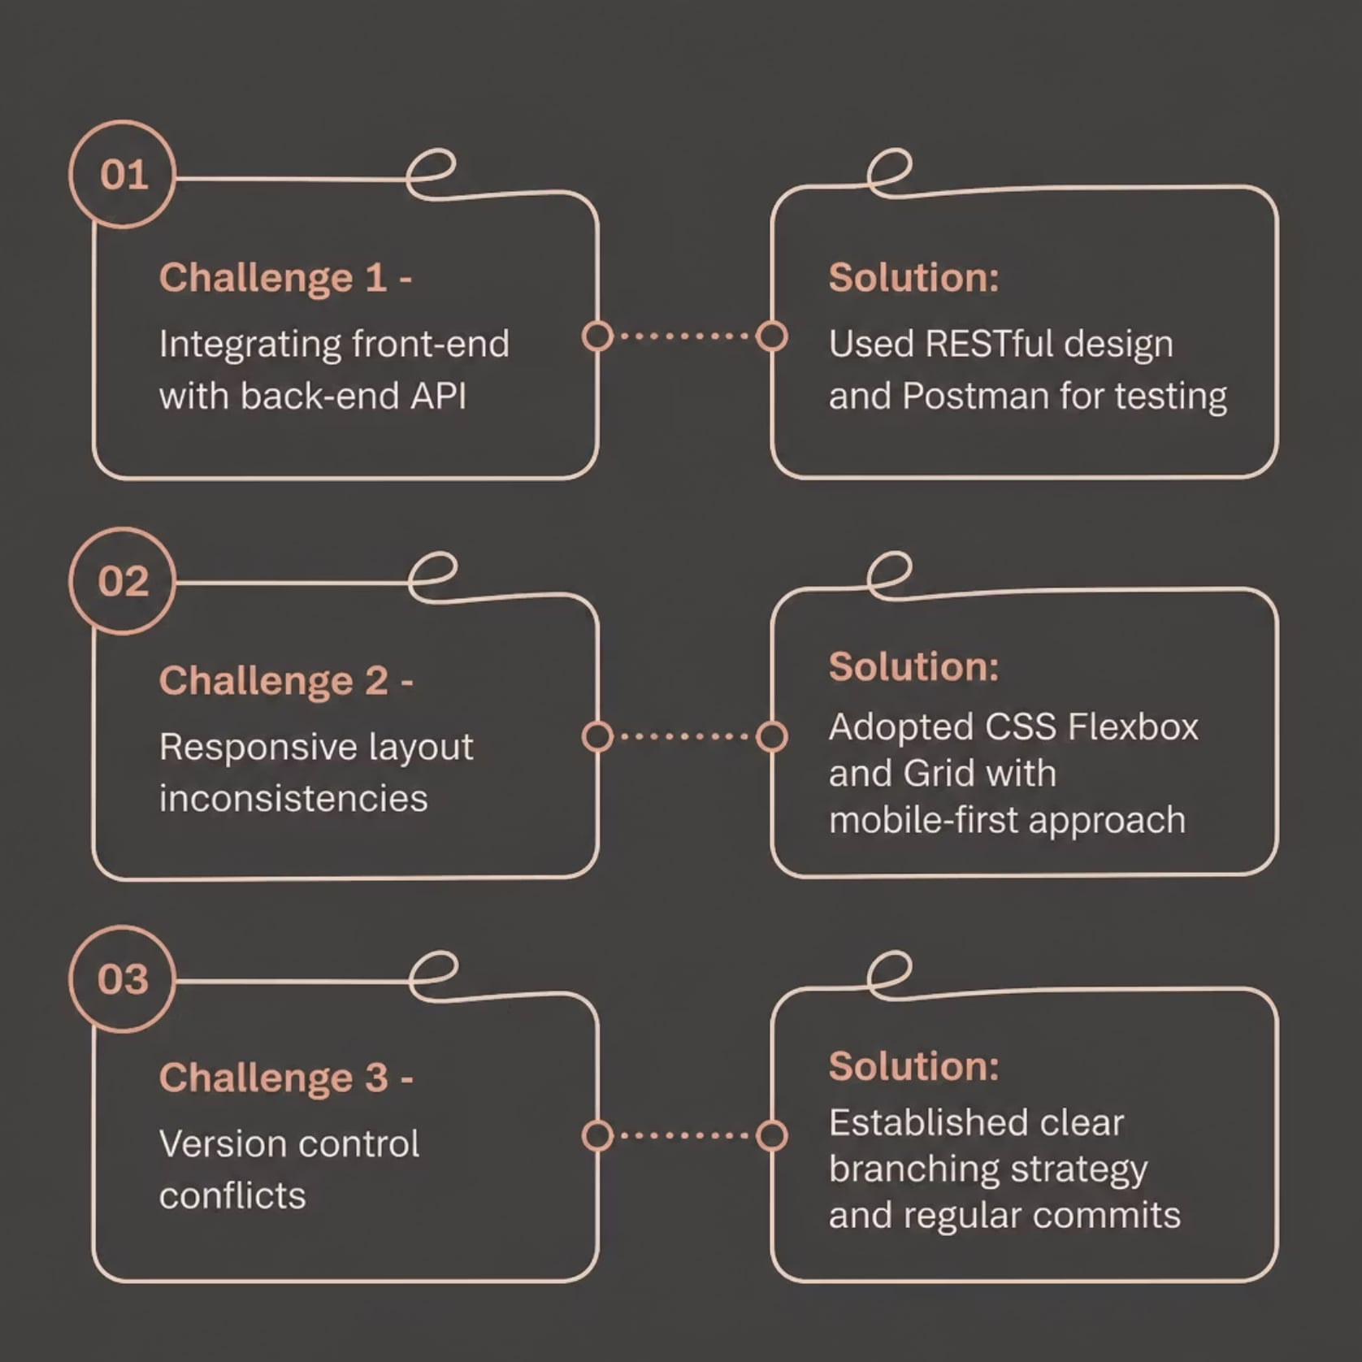

Challenges & Learning
Skills Gained
Full-Stack Development — End-to-end application building
Collaborative Coding — Git workflows and code reviews
Problem Solving — Debugging under real constraints
Professional Standards — Writing clean, maintainable code

Slide 10

Conclusion
Project Summary
Key Learnings
A fully functional web application built from concept to deployment, demonstrating practical software engineering skills in a real-world context.
Hands-on experience with Python, JavaScript, responsive design, version control, and agile development workflows at ApexPlanet.
Future Improvements
Add authentication, expand test coverage, integrate a database, and explore cloud deployment for scalability.
Thank you for your time and attention. I welcome any questions or feedback on this project.
APEXPLANET SOFTWARE PVT. LTD.
INTERNSHIP TASK 5 — CAPSTONE PROJECT

